Slide 1



Arboleum
A serious game about NC biofuels

Slide 2
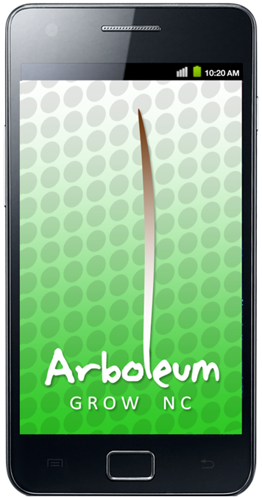
What it is-
A serious game simulating biofuel production for educational purposes.
A North Carolina specific game information based on our local climate and cultivated bioFuels.
A mobile platform game that goes based on real world mechanics and events.

Slide 3
What makes Arboleum unique?
Arboleum
The “usual” simulator
Arboleum utilizes real world events to drive gameplay, including prices, political developments and weather.
Arboleum’s gameplay experience in constantly shifting with the real world location of the player.
Arboleum isn’t just about fun. It’s aim to increase understanding and awareness surrounding the complex nature of biofuel production.
Gameplay is native to the game only. Scripts are generated by the gameplay and are not relative to events in the outside world.
Gameplay is situated in North Carolina.
While enriching through a playful experience, most other simulators are not trying to make a difference in the world.

Slide 4

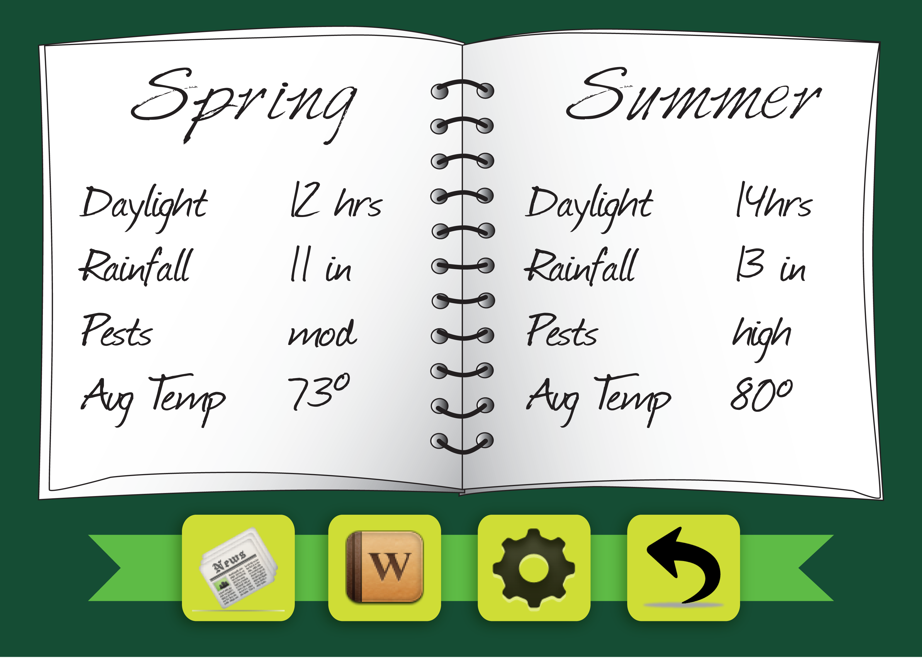
What will it look like?
Arboleum seeks to engender gameplay that is simple to understand, but at higher levels of play, extremely complex.
The game is played through an intuitive and simple haptic interface.
Complexity is achieved through a scenario system based on real-time weather, locational ecology, and daylight.

Slide 5
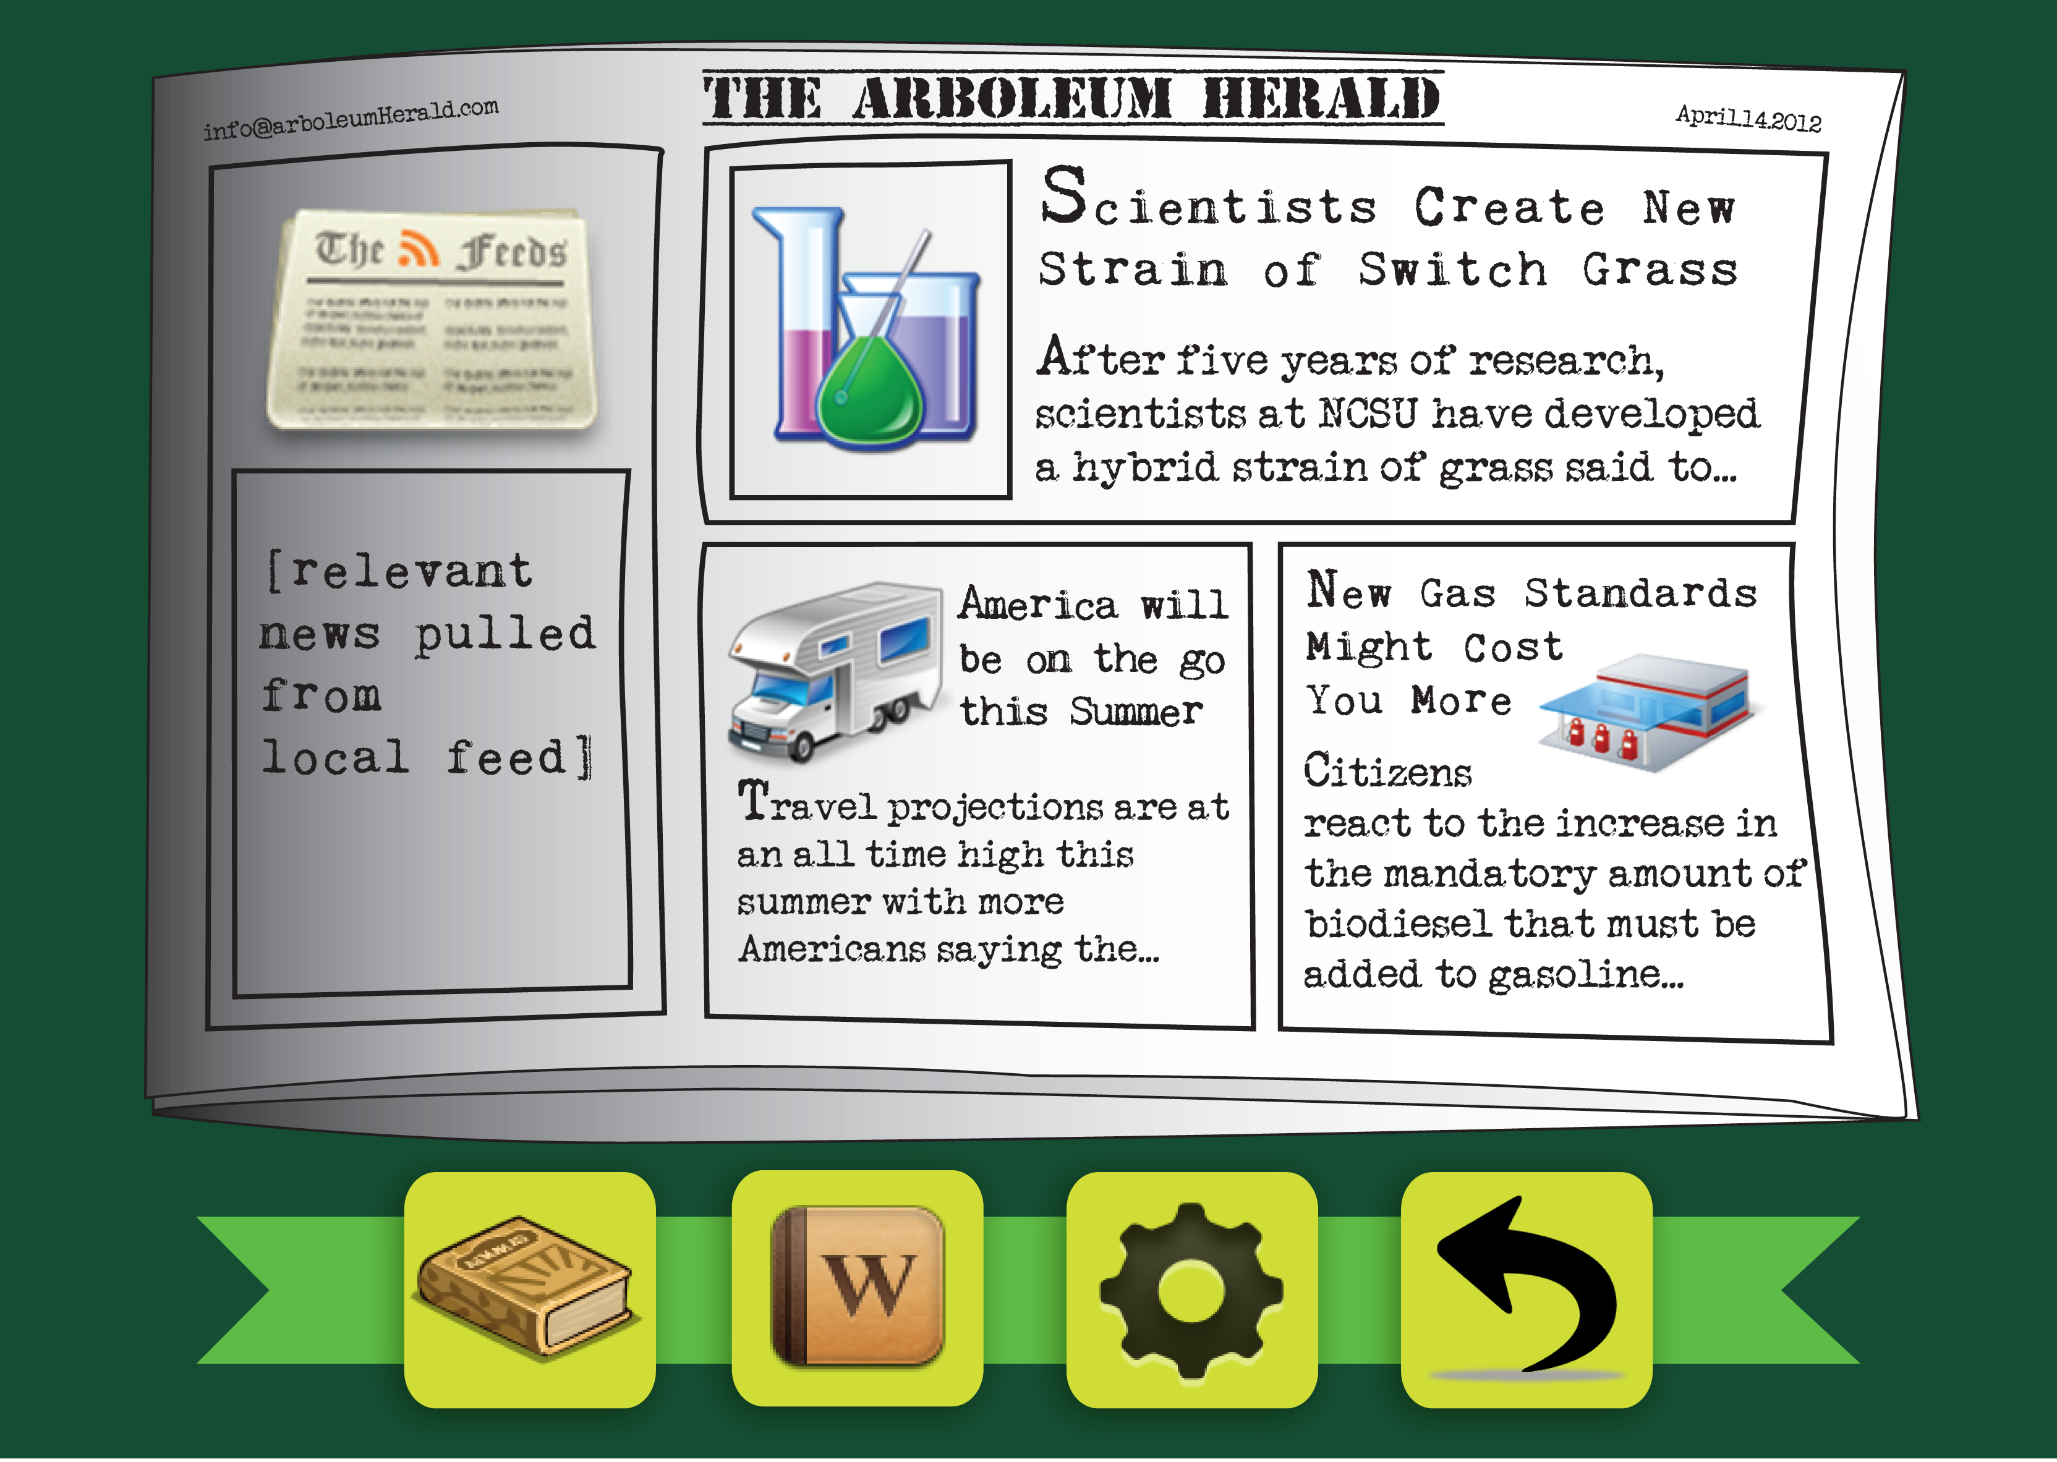

Slide 6
Complex Play
Arboleum not only simulates the complexities of growing biofuels through locational input. It also uses strategic resource management mechanics to emphasis production and consumption.
Conflicts between market value and location:
some plants won’t grow naturally in some areas. Will you alter the landscape and damage the environment to make a profit?
Scenario-based play:
Players will have to meet certain demands. How will you rehabilitate used-up land without subsidies? How will you make a large profit in a few weeks without burning out the land? What happens when pest levels are at an all-time high?
RPG elements:
player can “level up” their farm. But be careful, each improvement has consequences! Spending points on industrial infrastructure could have positive effects on your profits, but use up your land more quickly.

Slide 7

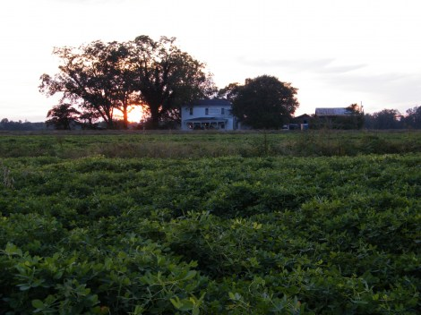
From the Coast
To the plains…

Slide 8
To Find A Different Game
Different Plants.
Different Scenario.
Different Temperature.
Different Daylight.
Different News.
Different Experience.

Slide 9
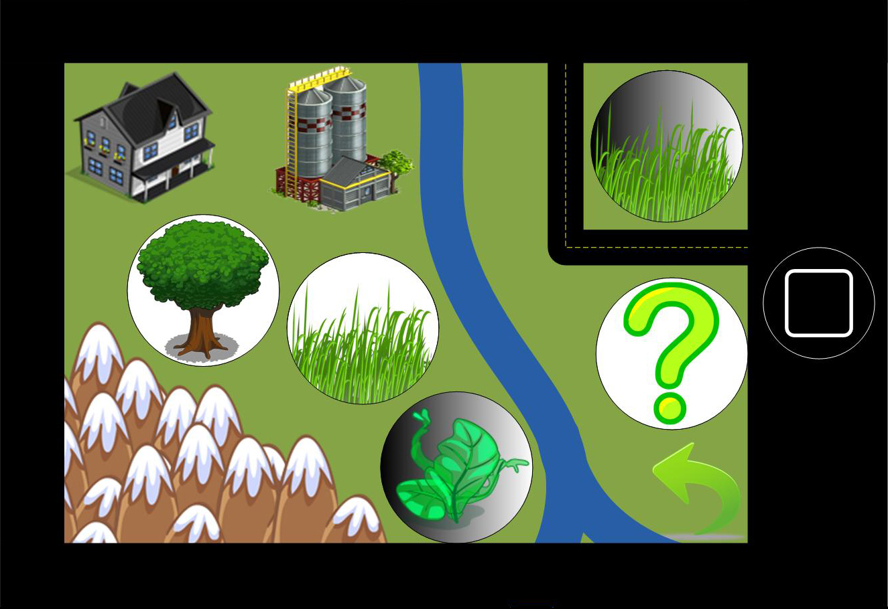

Slide 10
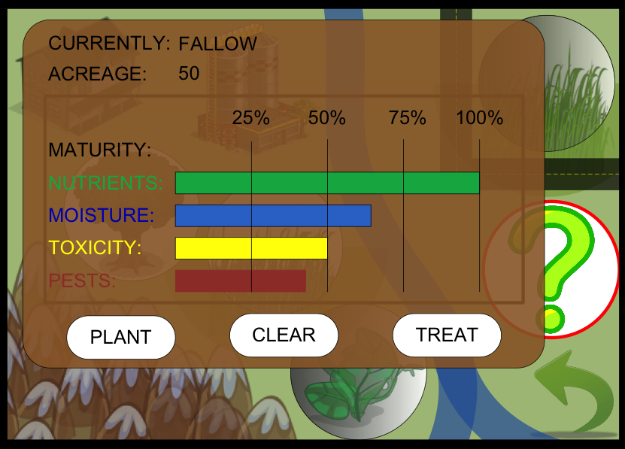

Slide 11
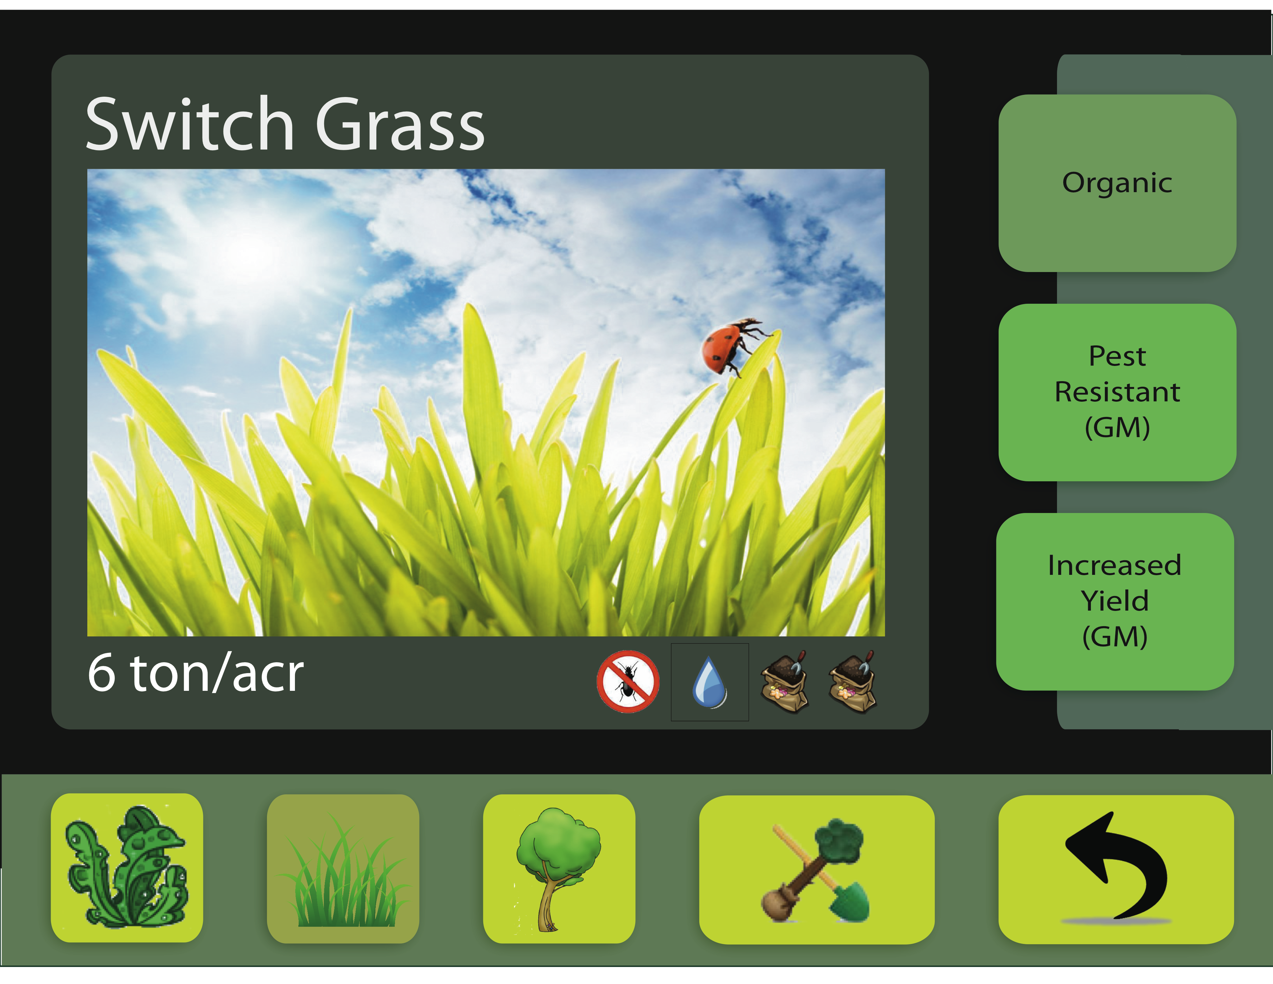

Slide 12
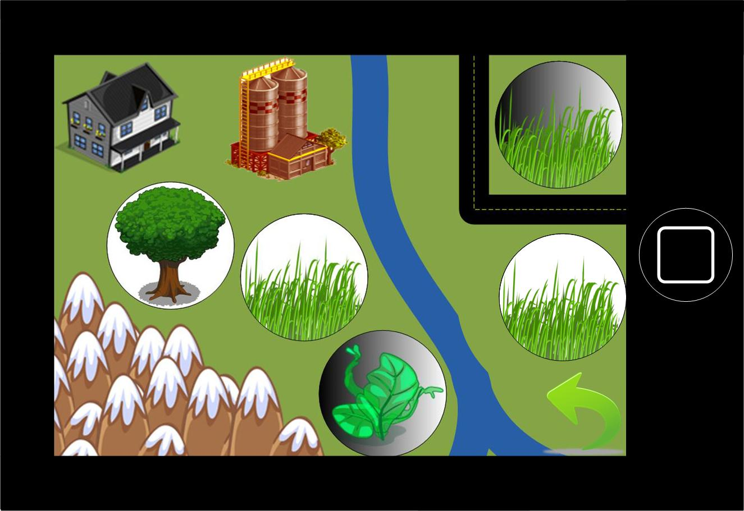

Slide 14
A New Virtual Mobility
Arboleum seeks to toy with people’s imagined mobility within a specific location.
Change the understanding of said location’s context
Arboleum encourages players to understand the land around them as a primary method for producing energy, thus changing the contextual meaning of being “at the beach” or “at grandma’s farmhouse.”

Slide 15


Play with you soon!
Music: The Advisory Circle.

